Slide 1
CPSC 457
CPU scheduling part 2
Contains slides from Mea Wang, Andrew Tanenbaum and Herbert Bos

Slide 2
CPU schedulers we have seen so far
already covered several schedulers
non-interactive (batch) systems:
first-come-first-serve (FCFS)
shortest-job-first (SJF)
shortest-remaining-time-next (SRTN)
interactive systems:
round-robin (RR)
multilevel queues
multilevel feedback queues

Slide 3
Today
more CPU scheduling algorithms for interactive systems:
shortest-process-next + exponential smoothing
fair-share
priority scheduling - lottery
real-time CPU scheduling
rate-monotonic
earliest-deadline-first
thread scheduling
user-level
kernel-level

Slide 4
Shortest-process-next
similar to SJF scheduling
uses time-sharing preemption (time slice)
ready queue is sorted by a predicted next CPU burst
prediction based on history of actual CPU bursts
predicted burst can be calculated using exponential smoothing:
after every burst B, we update the prediction P as follows:
P = a x B + (1 - a) x P'
where:
P is the new prediction, initialized to some value (eg. 0) P' is the previous prediction a is a smoothing factor, commonly set to ½

Slide 5
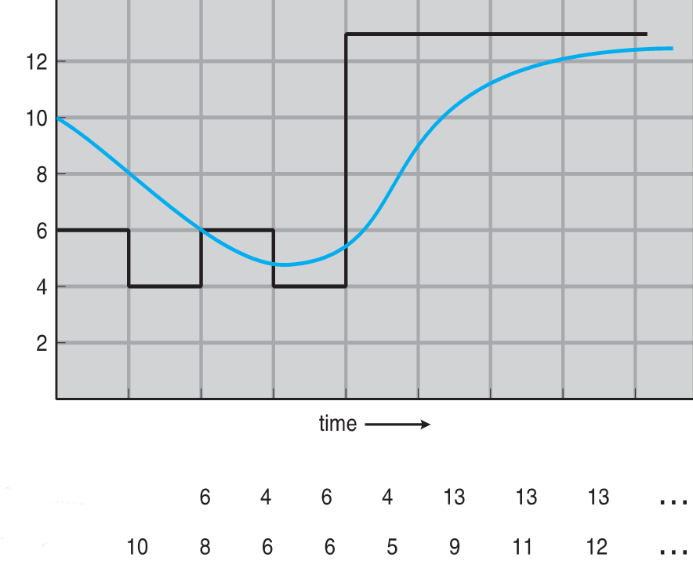
Predicting burst via exponential smoothing
B
P = a x B + (1 - a) x P'
P
actual bursts B:
predicted burst P:

Slide 6
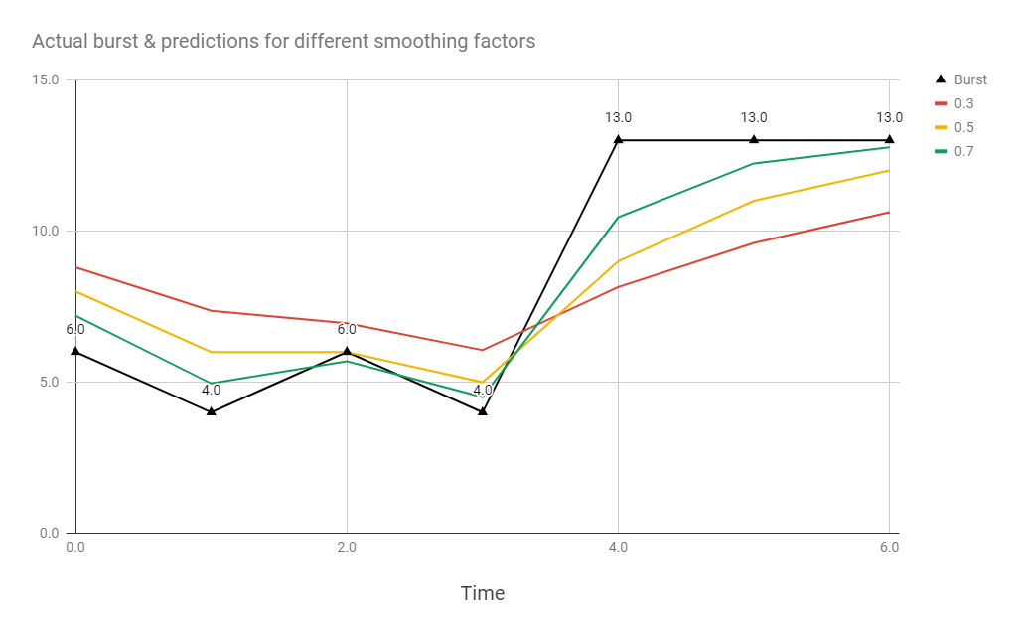
Exponential smoothing

Slide 7
Fair-share scheduling
note: not related to the CFS (completely fair scheduler) used in Linux
fair share scheduler takes into account the (importance of) owners of the processes
ensures all users of a system get a fair share of the CPU by allocating CPU among users or groups, instead of processes
solves problems like this:
user A runs 10 processes, user B runs a single process
so user A would get 90% of the CPU, user B only gets 10%
instead each user is allocated some fraction of the CPU
equal share: with N users, each user gets 1/N of the CPU
unequal share: important users get a big chunk of CPU time, and even more important users get an even bigger chunk of CPU time
then all processes belonging to an owner have to share the owner's CPU share

Slide 8
Fair-share scheduling
example: two users, user #1 runs 5 processes: A, B, C, D, E, and user #2 runs 1 process: F
scenario 1 – equal share, both users have 50% of the CPU possible scheduling sequences: A F B F C F D F E F A F B F C F D F E F A F B F C F D F E F … A B C D E F F F F F A B C D E F F F F F A B C D E F F F F F …
scenario 2 – unequal share, user 1 has 75% CPU share, user 2 has 25% CPU share possible scheduling sequences: A B C F D E A F B C D F E A B F C D E F A B C F … A B C D E A B C D E A B C D E F F F F F …

Slide 9
Priority scheduling
how do we handle processes with different priorities?
why would some processes be more important than others?
eg. priority could be determined by the VIP status of the owner
eg. background service (bittorrent) could have lower priority than an interactive one (game)
… many other reasons
important processes should get more CPU time than less important processes
the higher the priority of a process, the higher the CPU should be
priorities can be static or dynamic
static ― eg. bittorrent priority = 1, game priority = 10
dynamic ― eg. OS automatically increases I/O bound processes priority

Slide 10
Priority scheduling
with non-preemptive scheduling, a simple approach to handle priorities could work:
eg. consider SJF-like scheduling, where ready queue is sorted by priority
all jobs would eventually finish
although a newly added job with very high priority might have to wait for an already running lower priority job to finish first
fix?
handling priorities with time-sharing preemptive scheduling is more complicated:
eg. consider RR-like scheduling, where ready queue is sorted by priority
immediate problem is starvation
a high priority CPU-bound process would ensure no other processes get to run at all

Slide 11

Lottery scheduling (probabilistic scheduling)
preemptive time-sharing algorithm
each process gets some number of 'lottery tickets'
number of tickets based on process priority (min. tickets = 1) higher priority → more tickets
scheduler picks a random number and process with that ticket 'wins' a time slice of CPU
higher priority process has a higher chance of running
over long time, job's priority will determine the job's total CPU share
cooperating processes may exchange tickets
allowing dynamic fine-tuning the priorities based on needs
eg. in producer/consumer setting the producers could swap tickets with consumers
starvation is not a problem (why?)
technical issues with implementing efficient algorithm for large # tickets, # jobs

Slide 12
Real-Time OS CPU scheduling
programs are expressed as a set of tasks responding to events
a task must respond within a fixed amount of time from time of event (deadline)
correctness depends both on the logical result as well as the response time
tasks deadline types:
hard deadline: must meet its deadline, miss will cause system failure, needs Hard RTOS eg. missing interrupt in a pacemaker device
soft deadline: occasional miss is acceptable, needs Soft RTOS, eg. game lag, LOD
also firm deadline - between hard/soft, infrequent miss is tolerable, but value of task completion is 0 after deadline, eg. in automated manufacturing few bad products are OK
task types:
periodic: occurring at regular interval/period
aperiodic: occurring unpredictably

Slide 13
Rate-monotonic scheduling algorithm (RM)
RM is a preemptive scheduler, well suited for periodic tasks
each task has a static priority, based on the inverse of the period of the task
shorter period = higher priority, longer period = lower priority
when a task becomes runnable, task with highest priority preempts a task with lower priority
a formula can be used to determine whether a set of tasks is schedulable
schedulable: a schedule exists where no deadlines are missed
a new task could be rejected if the system would become unschedulable

Slide 14
Earliest-deadline-first scheduling algorithm (EDF)
EDF is another preemptive scheduler, with dynamic task priorities
a task with a shorter deadline has a higher priority
scheduler picks a task with the earliest deadline
an event for higher priority task will preempt lower priority task
optimal dynamic priority scheduling
if a schedule exists, EDF will find it
works better for aperiodic tasks than RM
can achieve 100% CPU utilization
a formula can determine whether tasks can be scheduled without missing deadlines

Slide 15
EDF example
Task | Event time | Deadline | Burst
1 | 0 | 30 | 7
2 | 1 | 8 | 5
3 | 2 | 20 | 11
4 | 3 | 5 | 2
Gantt chart:
1 | 2 | 2 | 4 | 4 | 2 | 2 | 2 | 3 | 3 | 3 | 3 | 3 | 3 | 3 | 3 | 3 | 3 | 3 | 1 | 1 | 1 | 1 | 1 | 1

Slide 16
Scheduling algorithms
Operating System | Preemption | Algorithm
Amiga OS | Yes | Prioritized RR scheduling
FreeBSD | Yes | Multilevel feedback queue
Linux kernel before 2.6.0 | Yes | Multilevel feedback queue
Linux kernel 2.6.0–2.6.23 | Yes | O(1) scheduler
Linux kernel after 2.6.23 | Yes | Completely Fair Scheduler
classic Mac OS pre-9 | None | Cooperative scheduler
Mac OS 9 | Some | Preemptive scheduler for MP tasks, and cooperative for processes and threads
macOS | Yes | Multilevel feedback queue
NetBSD | Yes | Multilevel feedback queue
Solaris | Yes | Multilevel feedback queue
Windows 3.1x | None | Cooperative scheduler
Windows 95, 98, Me | Half | Preemptive scheduler for 32-bit processes, and cooperative for 16-bit processes
Windows NT (including 2000, XP, Vista, 7, and Server) | Yes | Multilevel feedback queue
https://en.wikipedia.org/wiki/Scheduling_(computing)

Slide 17
Other schedulers
short-term scheduling aka CPU scheduling
responsible for allocating CPU to processes in memory ie. managing ready/blocking/waiting states
long-term scheduling
important in batch systems
decides which programs to start running, which ones to delay
typical goals are to achieve good mix of CPU-bound and IO-bound processes
medium-term scheduling
decides which programs to swap in/out when running low on resources, or when a process is idle for too long
I/O scheduling
ordering the I/O queues to increase throughput

Slide 18
Recap
Environment | Scheduling Algorithms
Batch systems | First come, first serve Shortest job first Shortest remaining time next
Interactive systems | Round robin Shortest process next Fair share Lottery Multilevel queue Multilevel feedback queue
Real-time systems | Rate-monotonic scheduling Earliest-deadline-first

Slide 19
Summary
scheduling algorithm goals
scheduling algorithms:
shortest-process-next, fair-share, lottery, multilevel queue, multilevel feedback queue
real-time CPU scheduling:
rate-monotonic, earliest-deadline-first
thread scheduling
Reference: 2.4.1 - 2.4.6 (Modern Operating Systems) 5.2 - 5.4 (Operating System Concepts)

Slide 20
Review
Why is the length of the time quantum important for RR?
Can processes experience starvation when using RR scheduling?
In a multi-level feedback queue, processes are guaranteed to be free from starvation. True or False or It Depends
If a thread executes a blocking system, will that suspend the entire process?

Slide 21
Questions?

